Slide 1
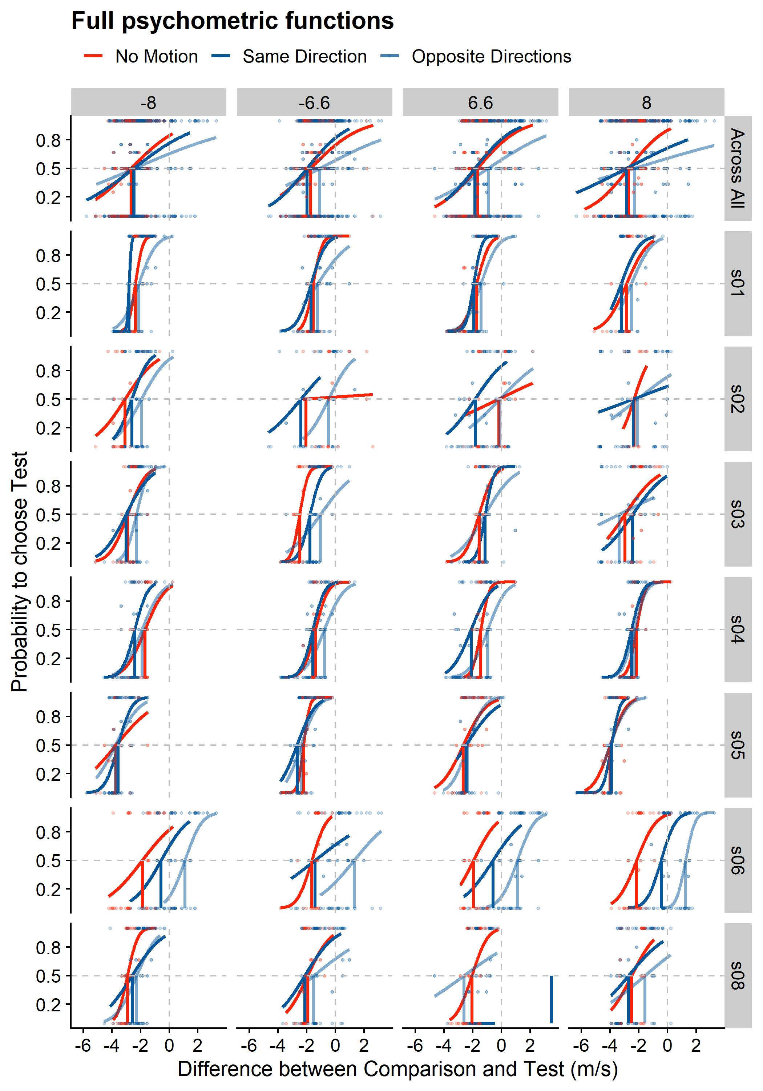
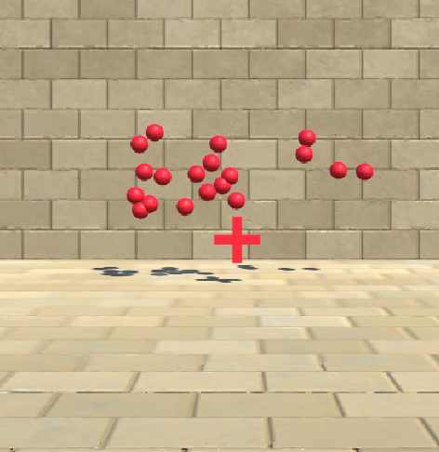
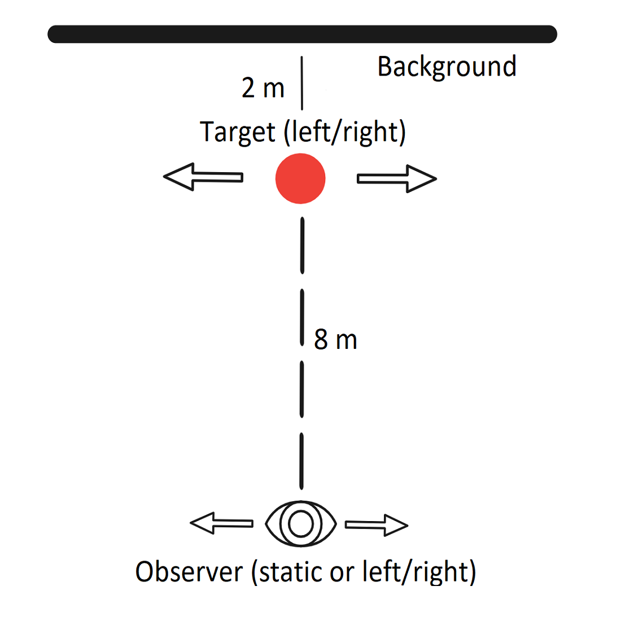
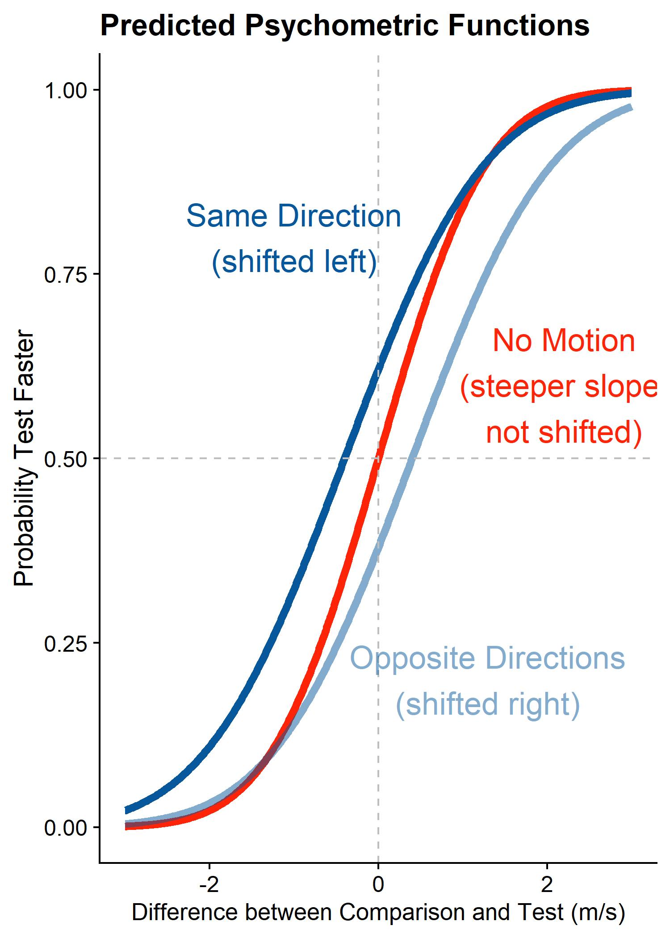
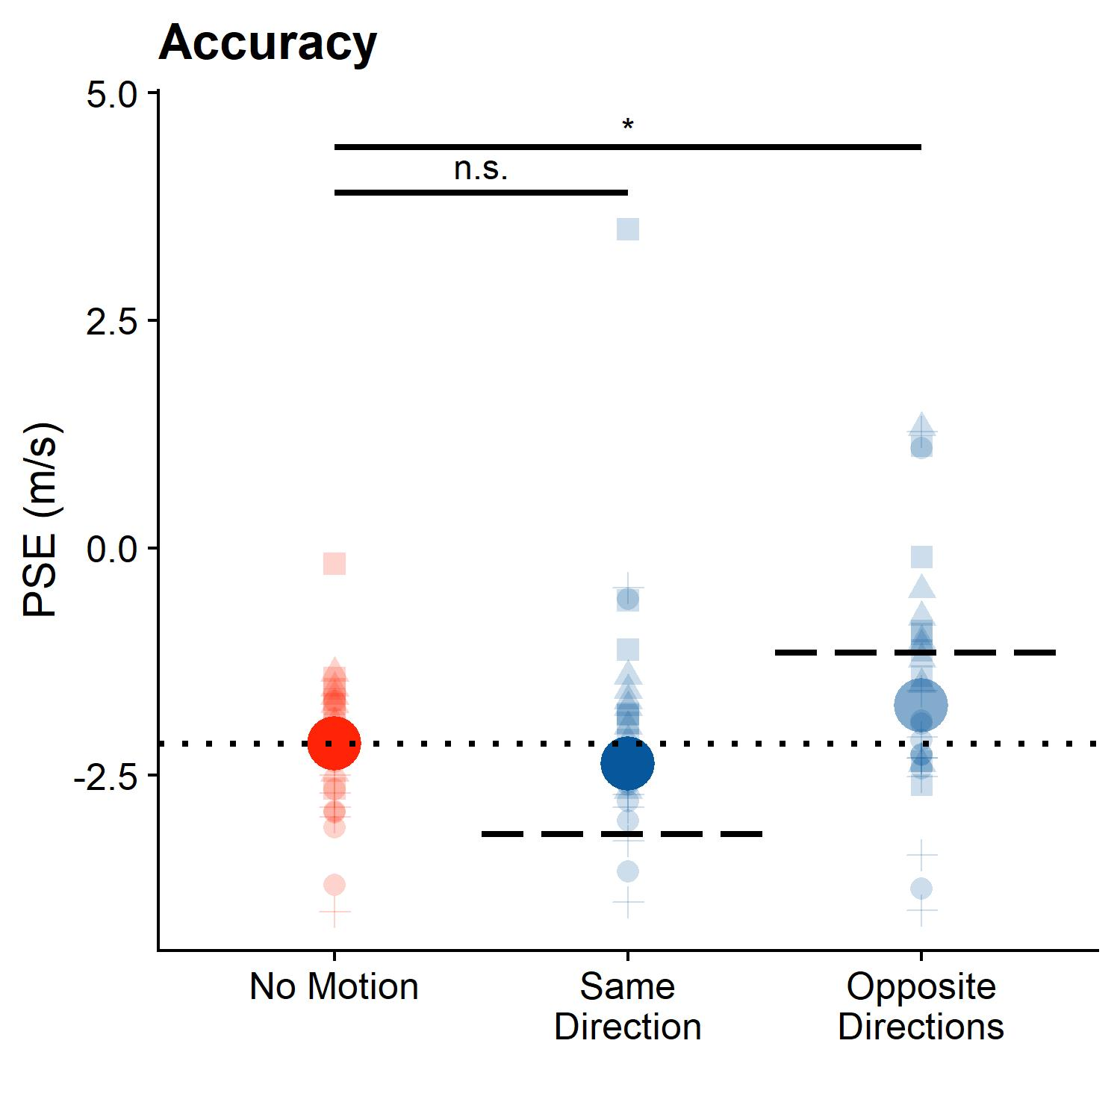
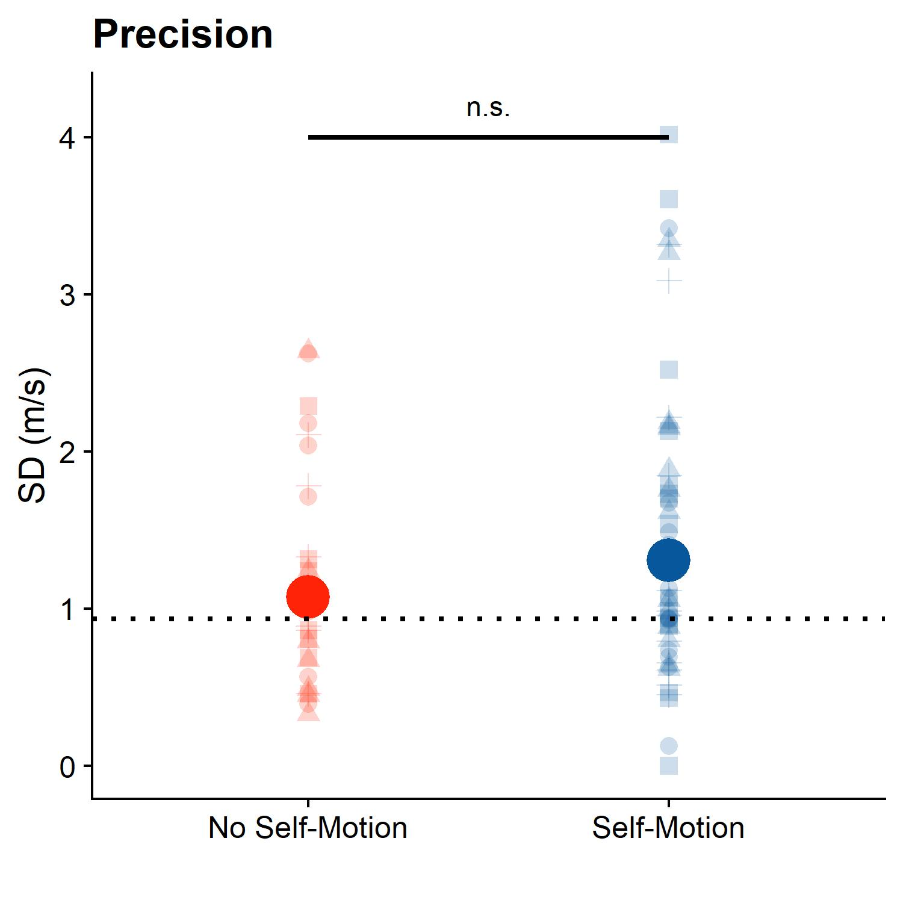


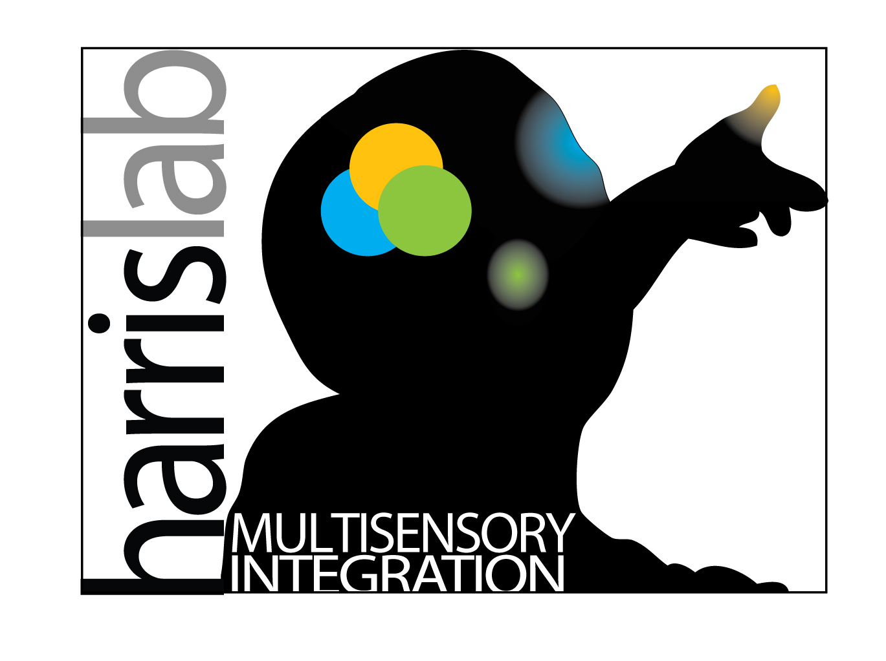


Incomplete Compensation for Self-Motion in the Visual Perception of Object Velocity during a Visual-Vestibular Conflict
Björn Jörges, Laurence R. Harris
Center for Vision Research, York University
bjoerges@yorku.ca
Twitter: @b_jorges
Background & Objectives
Methods
Retinal motion elicited by an object is ambiguous and can be due to:
object motion
self motion
Estimating self-motion is a multisensory process:
vestibular
visual
efference copies
Can we compensate for self-motion in the absence of efference copies and vestibular cues? Does compensation decrease precision?
TEST: SAME DIRECTION TRIAL
COMPARISON
TEST: OPPOSITE DIRECTION TRIAL
-8 m/s
-6.6 m/s
6.6 m/s
8 m/s
motion from self-motion (optic flow)
motion from self-motion (optic flow)
motion from object-motion
motion from object-motion
Figure 4: Psychometric functions per participant (rows of panels; the first row with the blue shading shows the psychometric functions fitted across participants) and standard velocity (columns of panels); negative velocities correspond to leftwards object motion. The cross made up of dashed lines indicates perfect accuracy. The translucent dots correspond to response fractions per stimulus strength. We flipped responses around for leftwards motion to make the psychometric functions more easily comparable.
self motion
No observer motion
self motion
Figure 2a: Participant view – test, same directions condition
Figure 2b: Participant view – comparison
Figure 2c: Participant view – test, opposite directions condition
The task: Which of two presented motions is faster?
Hypothesis 1: self-motion and object motion in the same direction in absence of vestibular cues /efference cues lead to am inadequate compensation, i.e., an underestimation of target velocity, and to an overestimation of target velocity when self-motion and object motion are in opposite directions
Prediction 1: curve shifted left (for same direction) or right (for opposite directions) indicating lack of compensation
Hypothesis 2: self-Motion leads to noisier judgments
Prediction 2: Psychometric function shallower when self-motion is present
The stimuli (GIF available here)
Two motion intervals presented at eye-height in 3D virtual environment
One big target (6.6 or 8 m/s left or right; Fig. 2a/2c), one ball cloud (velocity PEST staircase-controlled, Fig. 2b, with up to 35 trials per staircase)
Figure 2d: top view of stimulus
Participant moved visually in the same or opposite direction as the target, or static during observation of big target (Gaussian motion profile, 1 m/s average speed across 0.5 s); no physical motion
Dependent variables: Mean and slope of psychometric function
Results
Ball cloud perceived as much faster than single target (consistently negative PSEs)
Hypothesis 1: On average, motion in the opposite direction is judged as too fast (p < 0.05, about 70% compensation) and motion in the same direction is judged roughly as accurately as no motion (p = 0.8, nearly full compensation)
Hypothesis 2: On average, subjects judge speed somewhat less precisely when self-motion is simulated (p = 0.09)
Figure 1: Predicted psychometric functions
Open Science, Acknowledgments & References
All resources, including a Stage 1 Registered Report submitted to Attention, Perception and Attention, are available here. We thank the Canadian Space Agency for partial funding of this project.
0% compensation
VISTA
100% compensation
0% compensation
Conclusions
Figure 3: Big solid dots – median PSEs (accuracy, left) and SDs (precision, right) of the psychometric functions across participants and velocities. Translucent dots – data per participant and standard velocity. Dashed lines – median value for stationary observer. Dotted lines indicate 100% compensation for self-motion, dashed lines indicate 0% compensation.
We compensate nearly fully for self-motion in the same direction as the target, and about 70% for motion in the opposite direction, even when vestibular and efference copy cues are unavailable. This comes at the cost of a marginally lower precision compared to no self-motion.
[1] Dokka, K., MacNeilage, P. R., DeAngelis, G. C., & Angelaki, D. E. (2015). Multisensory self-motion compensation during object trajectory judgments. Cerebral Cortex, 25(3), 619–630. https://doi.org/10.1093/cercor/bht247
[2] Dupin, L., & Wexler, M. (2013). Motion perception by a moving observer in a three-dimensional environment. Journal of Vision, 13(2), 1–14. https://doi.org/10.1167/13.2.15

